Slide 1
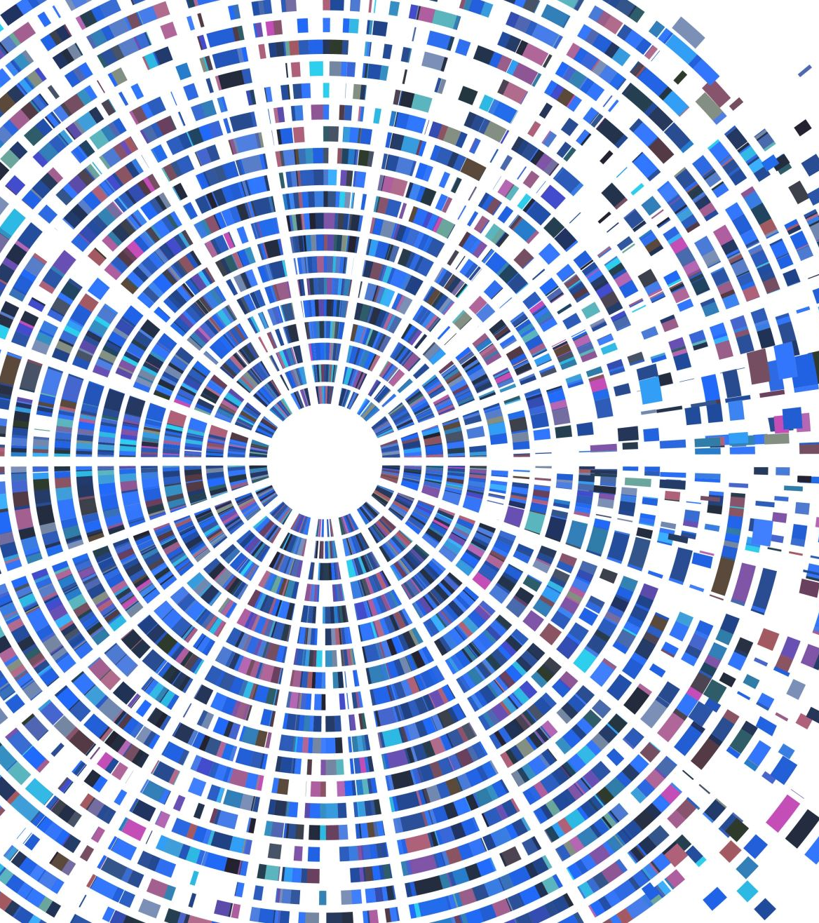
Target Capture data analysis
Workshop, Bergen, 2022
Martha Kandziora
Seth Musker

Slide 2
What and why.
Most plant, animal and fungal genomes are large.
Sequencing whole genomes?
costly
analysis is challenging.
For phylogenetics, we don’t want too much or too little data.
Target capture = selectively sampling the genome.

Slide 3
Target Capture is like fishing
You choose your bait(s) so that you know what you’re getting (mostly).
But you often get more than you bargained for.
Sometimes you must make do with less.

Slide 4
Gnirke et al. 2009, Nature.

Slide 5
Restriction-site genome sampling;
aka RAD-seq, GBS
Target-capture genome sampling;
aka Hyb-Seq, AHE, UCE, etc.
McCormack et al. 2013, MPE.

Slide 6
It’s still a lot of data…
Hundreds to thousands of targets.
Millions of raw reads.
Many options for data processing from reads to sequence alignments.
All options are computationally demanding.
All options require time and effort.
Martha: HybPhyloMaker
Seth: HybPiper (containerized)

Slide 7
Don’t always know what we’re getting
General-use target sets may end up capturing problematic loci
Notably, paralogs (genes with similar sequence but different evolutionary histories) are bad for phylogenetics
How to detect them?
Martha: ParalogWizard
Seth: TargetVet
How to use them to your advantage?
Martha: ParalogWizard

Slide 8
How does TargetVet find paralogs?
Per sample:
Collate assembled contigs from HybPiper output;
Blast contigs to the target fasta;
Parse blast results, calculating paralogy indices based on shared alignments.
Across samples:
Identify shared paralogy patterns and estimate sets of single copy loci and paralogs.

Slide 9
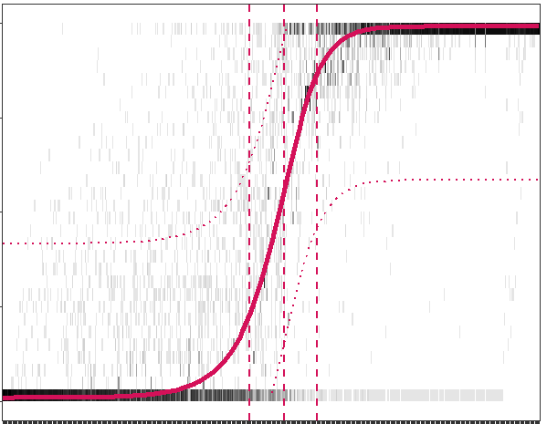
Workflow: Paralog detection using TargetVet and HybPiper results – VetHybPiper.sh
Target fasta
Paralogy matrix
Assemblies
T1
BLAST alignments
Targets
Collated
T2
t1
T3
Paralogy = 10%
 | T1 | T2 | T3 | T4
S1 | 10 | 80 | 60 | …
S2 | 5 | 90 | 65 | …
S3 | … | … | ... | ...
S4 | … | … | … | …
T1
Sample 1
t2
BLAST
Paralogy = 80%
T2
t3
Paralogy = 60%
Samples
T3
Target fasta
Assemblies
T1
BLAST alignments
Collated
T2
t1
T3
Paralogy = 5%
Sample 2
T1
t2
BLAST
Paralogy = 90%
T2
t3
Paralogy = 65%
T3
More samples
T1
T3
T2

Slide 10
What to do with the results
The Great Paralog Debate:
Exclude paralogs and make your life easier, but lose a lot of potentially crucial data?
OR
Embrace paralogs and use them to your advantage? (you’ll have to work much harder, but it’ll most likely be worth it…)

Slide 11
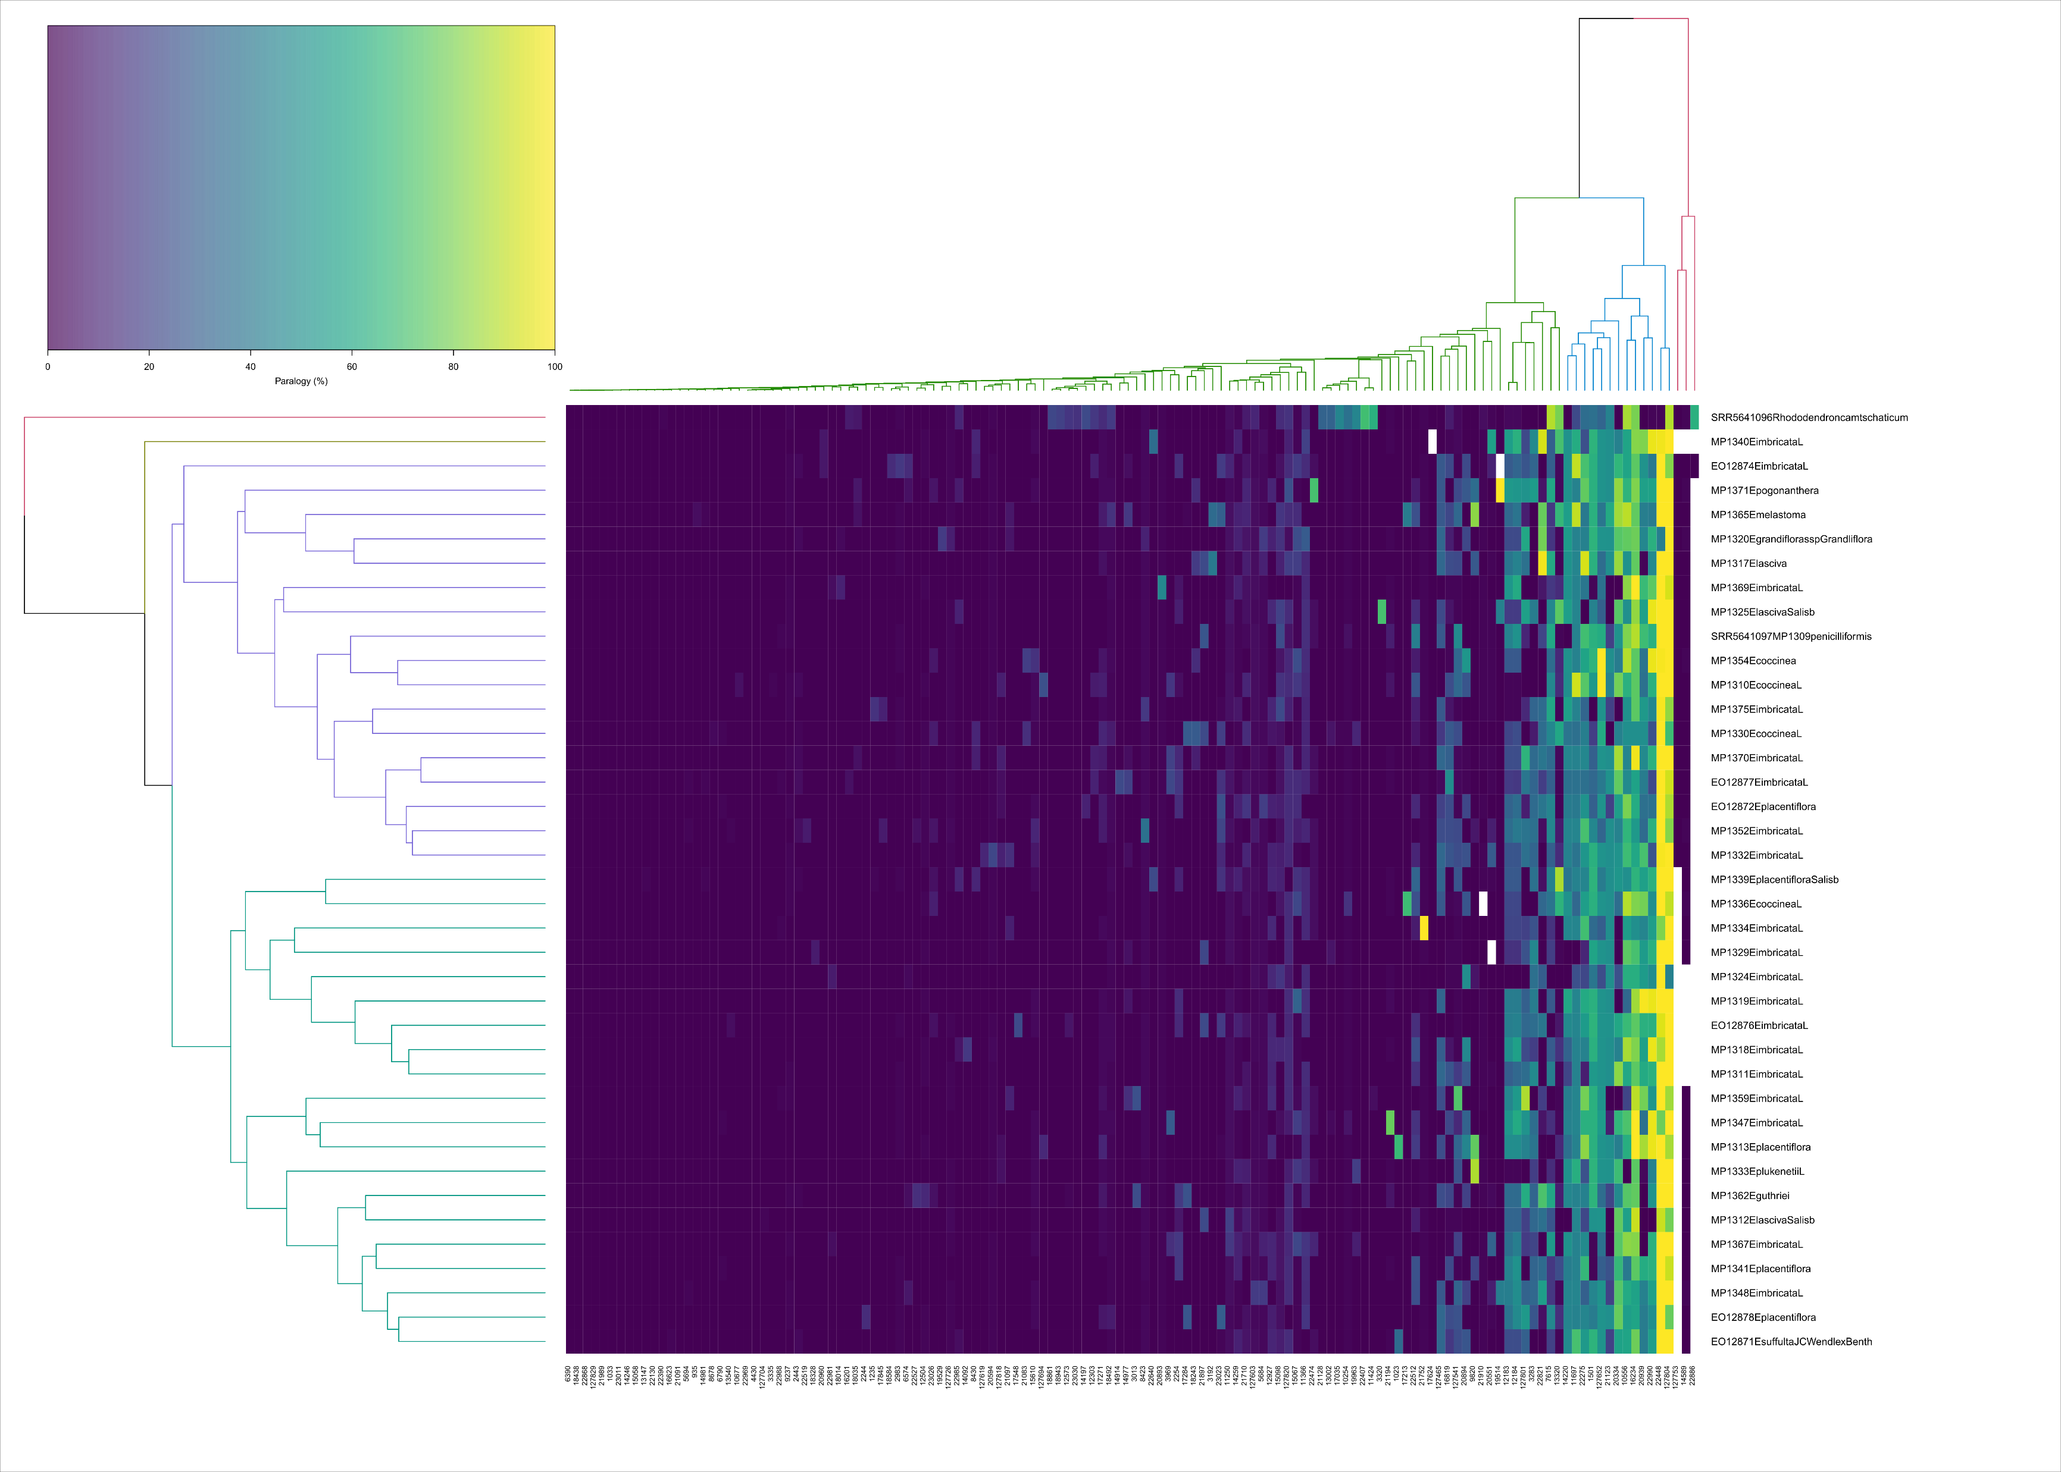

Slide 12
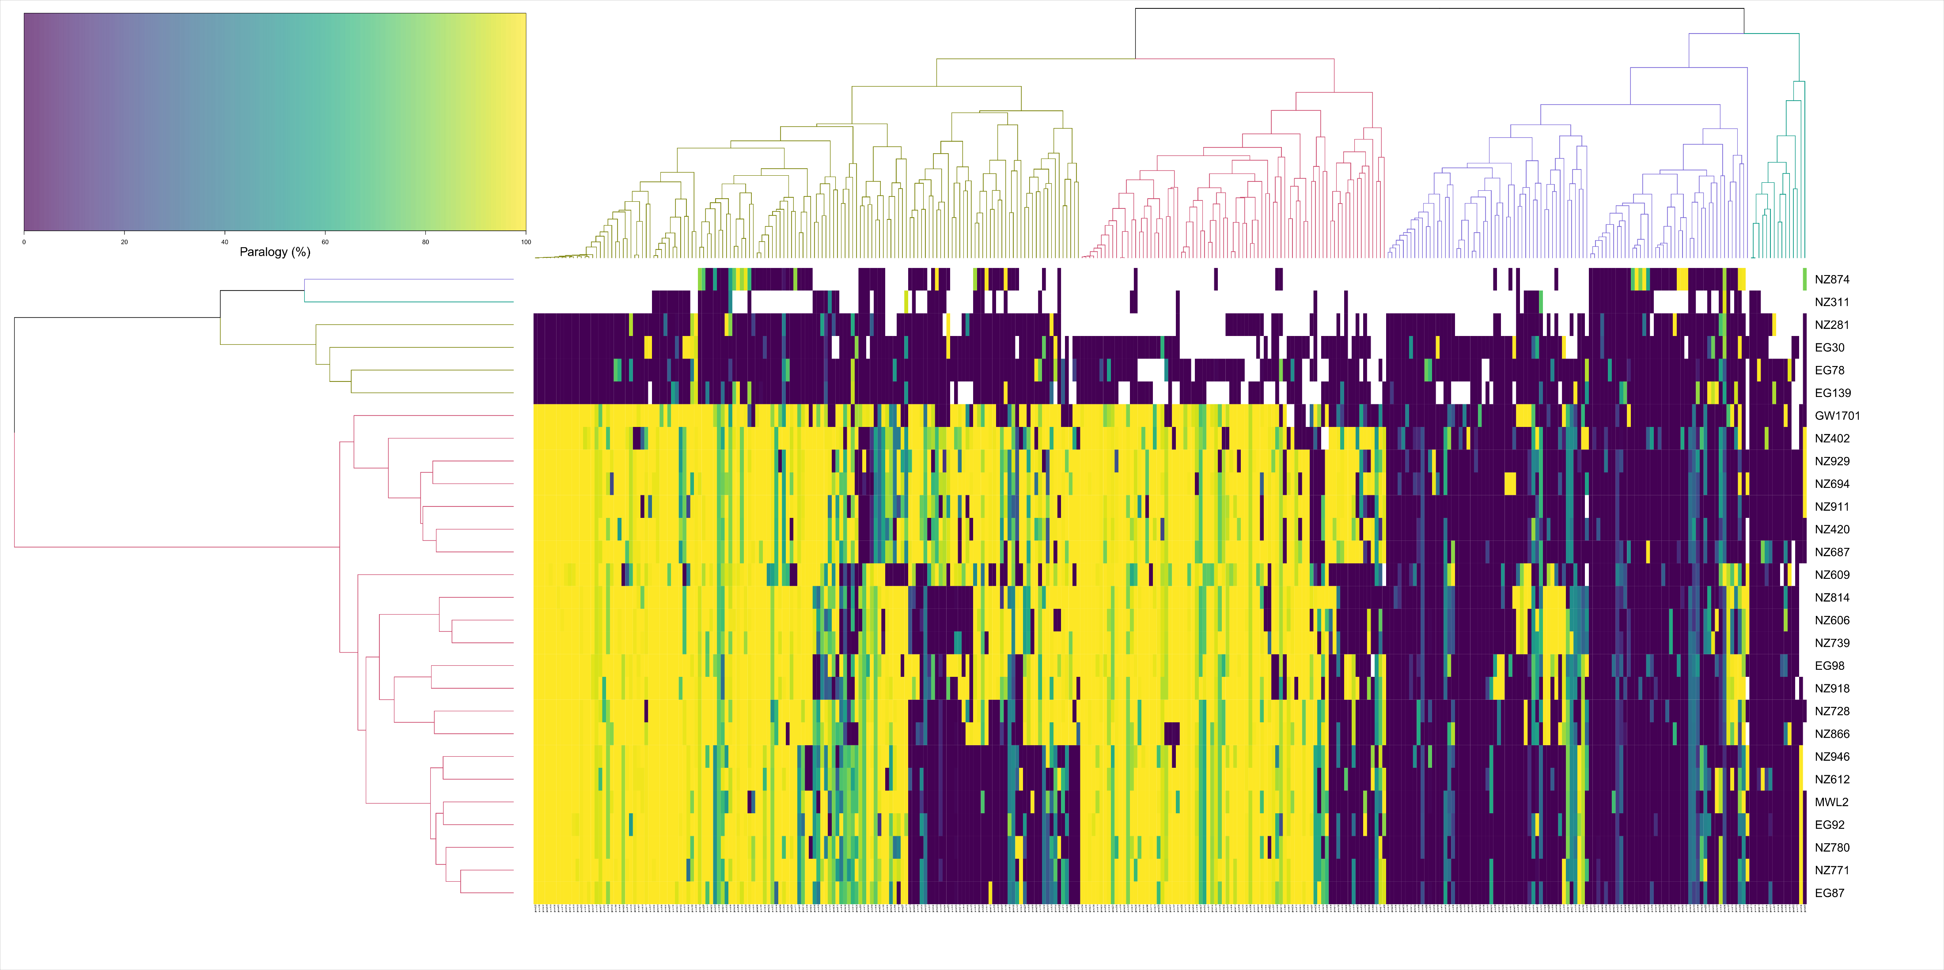

Slide 13
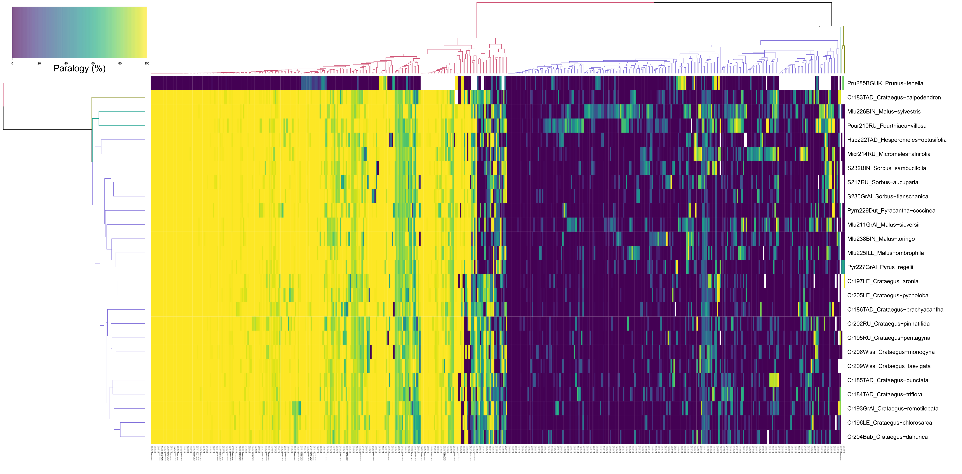

Slide 15
Faircloth et al. 2012, Sys. Biol.

